Slide 1
Load Balancers

Slide 2
Load Balancers
GCP offers various types of load balancers
Target different scenarios
We’ll learn about the different types and when to use each
We’ll integrate some of them in our ReadIt app

Slide 3
Why we need Load Balancer?
It is a cloud service that distributes load and checks health of instances
When an instance is not healthy – no traffic is directed to it
Can work with various types of backends
Can be external or internal
Operates at layer 4 or 7 of the OSI model

Slide 4
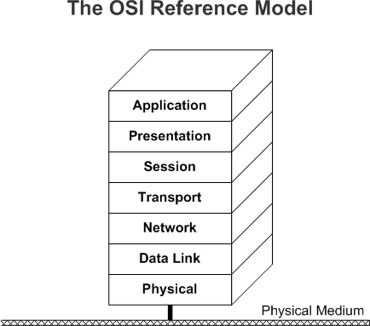
7 Layers Model
Layer 7: Interacts with the application. Can see the content of the transmission. Example: HTTP URL + path + params
Layer 4: Knows about IP, Port, protocol, TLS and more. Has no knowledge about the actual content

Slide 5
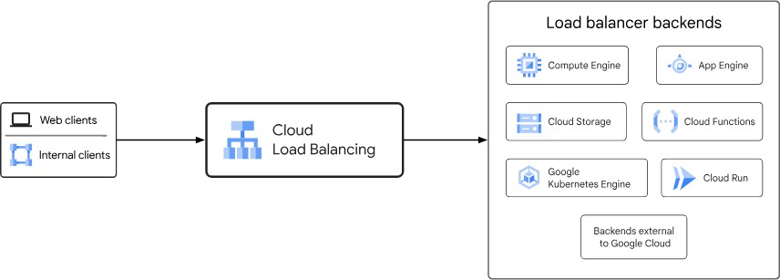
Cloud Load Balancer

Slide 6
Load Balancer Distribution Algorithm
Depends on the load balancer type
Load balancing can be based on 5 tuple hash:
Source IP
Source port
Destination IP
Destination port
Protocol type
These tuples are similar to what are used by Firewall Rules
Or Load balancing can also be based on backend utilization, weights and more

Slide 7
Load Balancer Rule of Thumb
In general, always use load balancer as the front of your app
Never expose VM / AE / GKE etc. directly to the internet

Slide 8
Load Balancer Types
GCP offers various types of load balancers
It’s important to choose the right one for your scenario
Differences in various factors:
Traffic type
Traffic source like External or internal
Deployment mode

Slide 9
Traffic Type
What kind of traffic is going to go through the load balancer
HTTP/S :- Application Load balancer and works at layer 7
Use as a front of a webapp
Can route based on url path, like if url has “order-value” in it then send traffic to specific backend
Proxy based which means traffic ends at LB and LB starts a diff session to communicate with backend
TCP :- Network load balancer and works on layer 4
Use as Front to a TCP listener
Proxy based
TCP,UPD, ICMP, etc :- Passthrough Load Balancer, works at Layer 4
Distribute traffic om multiple network protocols
Traffic is terminated at backend not at load balancer
Notes:
Proxy Based :- Well, a proxy based load balancer means that the traffic reaches the load balancer and there the traffic
terminates.
And the load balancer creates a new channel from the load balancer to the back end.
So this is not the same traffic that arrived at the load balancer.
It's a different request with a different channel.
So this is something that you should consider.
And it provides opportunity to make some customizations to the traffic.
For example you can do SSL termination meaning the traffic to the load balancer is going to be encrypted
using SSL or TLS.
But from the load balancer itself to the back end, traffic will not be encrypted in order to improve
performance.
So this is possible in a proxy based load balancer.

Slide 10
Traffic Source
Depends on source of traffic like external or Internal
External
Traffic comes from internet
Suitable for public websites, applications
Internal
Traffic comes from internal network, like inside VPC or some other internal network
Example, backend services calling each other

Slide 11
Deployment Mode
Where the traffic load is distributed
Global
LB deployed in all regions
Greate for DR scenarios
Only in External LB
Cross-Region
Deployed in multiple regions
Resilient to regional outage
Only in internal load balancers
Regional
Deployed in single region
Distributed across multiple zones
Serves apps in specific region

Slide 12
Load Balancer Types
Type | Deployment Mode | Use For…
Application Load Balancer (HTTP/S) | Global external | Public global websites distributed in multiple regions
 | Regional external | Public global websites distributed in a single region
 | Regional internal | Intra-backend communication distributed in a single region
 | Cross-region internal | Intra-backend communication distributed in multiple regions
Proxy Network Load Balancer (TCP) | Global external | Public TCP listener distributed in multiple regions
 | Regional external | Public TCP listener distributed in a single region
 | Internal | Internal TCP listener
Passthrough Network Load Balancer (TCP, UDP, ICMP…) | External | Public network listener
 | Internal | Internal network listener

Slide 13
Load Balancer Pricing
All load balancers EXCEPT internal application load balancer:
First 5 forwarding rules | $0.025 / hour
Additional forwarding rule | $0.01 / hour
Inbound data processed | $0.008 / GiB / month
Outbound data processed | $0.008 / GiB / month

Slide 14
Load Balancer Pricing
Internal application load balancer (regional and cross-region):
Per instance | $0.025 / hour
Inbound data processed | $0.008 / GiB / month
Outbound data processed (only in cross-region LB) | $0.008 / GiB / month

Slide 15
Load Balancer and App Engine
App Engine has its own load balancer
Provides basic load balancing capabilities with the autoscaling of App Engine
Sometimes it’s a good idea to still have Load Balancer on top of App Engine, below are some of reasons for this
Advanced capabilities not found in the built-in load balancer line CDN integration
Balancing between two or more App Engines in different projects

Slide 16
Affinity
Makes sure user will always be directed to the same
instance (VM / App Engine) it began with
Should be avoided when possible
Usually required in Stateful apps
Usually a sign of bad design
Always try to design Stateless app

Slide 17




Stateless
The application’s state is stored in only two places – the data store and the user interface
State = Application’s Data

Slide 18
Stateless Example
User Interface
Send user / password
Log In Service
Store user for future use
Data stored in code = Stateful
Retrieve user details
Check user / password exists
Database

Slide 19
Scalability - A Reminder
Grow and shrink as needed
Scale Up vs Scale Out
Scale Out is usually preferred

Slide 20
Redundancy - A Reminder
Allows the system to function properly when resource
is not working
Example:
A system with more than one server
When a server goes down, the other continue working

Slide 21
Scalable & Redundant Architecture
User Interface
Distributes Load
Routes to live services only
Scalability
Load Balancer
Redundancy
Is Alive?
Log In Service
Log In Service
Log In Service
Database

Slide 22
Stateful Example
User Interface
Send user / password
Load Balancer
User / password sent to Service #1
Log In Service
Store user for future use
Log In Service
Log In Service
1
2
3
Retrieve user details
Check user / password exists
Database

Slide 23
Stateful Example
User Interface
Add item to shopping cart
Please
Log In
Load Balancer
Request sent to
Service #2
Cart Service
Stored user details
Cart Service
Cart Service
1
2
3
Database

Slide 24
Stateless Example
User Interface
Add item to shopping cart
Load Balancer
Action sent to
Service #2
Cart Service
Cart Service
Cart Service
1
2
Check for user details
3
Database
Stored user details

Slide 25
Stateless
Always use stateless architecture
Supports Scalability and Redundancy

Slide 26
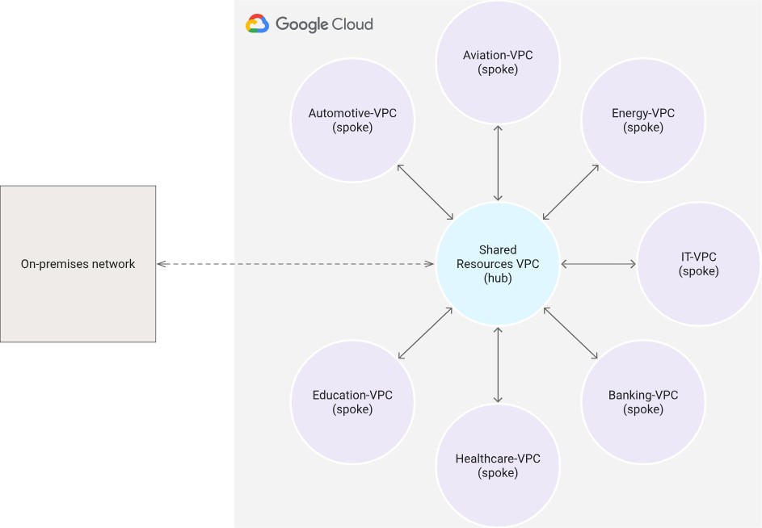
Secure Network Design
Hub and Spoke

